Slide 1
Non-Deterministic Finite Automata
Automata Theory
Ege University
Department of Computer Engineering
Yrd. Doç. Dr. R. Cenk Erdur, 2012

Slide 2
“Non-Determinism
In “Non-deterministic” models, finding
out a path is not only dependent on
the input given. The model has to
decide. (Human factor or artificial
intelligence).
4
b
3
....
???
b
5
Yrd. Doç. Dr. R. Cenk Erdur, 2012

Slide 3
Definition
A non-deterministic finite automata (NFA) is a collection of three things:
  A set of states one of which is a start state, and one or more of which are finite states.
  An input alphabet.
  Transitions from one state to another. Null ( Λ ) transition is not allowed.
Yrd. Doç. Dr. R. Cenk Erdur, 2012

Slide 4
Theorem
For every FA, we can build a NFA that accepts the same language.
Example:
  The language of all words that contain either triple a or triple b).
  NFA and FA are given in the following slides.
Yrd. Doç. Dr. R. Cenk Erdur, 2012

Slide 5
Example NFA
a,b
a
a
+
a,b
a
-
a,b
b
+
b
b
Yrd. Doç. Dr. R. Cenk Erdur, 2012

Slide 6
DFA for the Same Language
a
a
a
a
a,b
b
-
b
a
+
b
b
b
Yrd. Doç. Dr. R. Cenk Erdur, 2012

Slide 7
Question
Alphabet={0,1} is given. L is the language of all words that end with 01. Build FA and NFA models for L.
Yrd. Doç. Dr. R. Cenk Erdur, 2012

Slide 8
Labyrinth Example
Is it possible to exit in six steps?
-
1
2
3
4
5
6
7
8
9
+
Yrd. Doç. Dr. R. Cenk Erdur, 2012

Slide 9
Labyrinth Example
a
a
1
2
+
......
a
a
a
a
a
a
Is the string aaaaaa accepted
by this model?
Can you write a RE?
-
3
a
a
a
4
.......
a
Yrd. Doç. Dr. R. Cenk Erdur, 2012

Slide 10
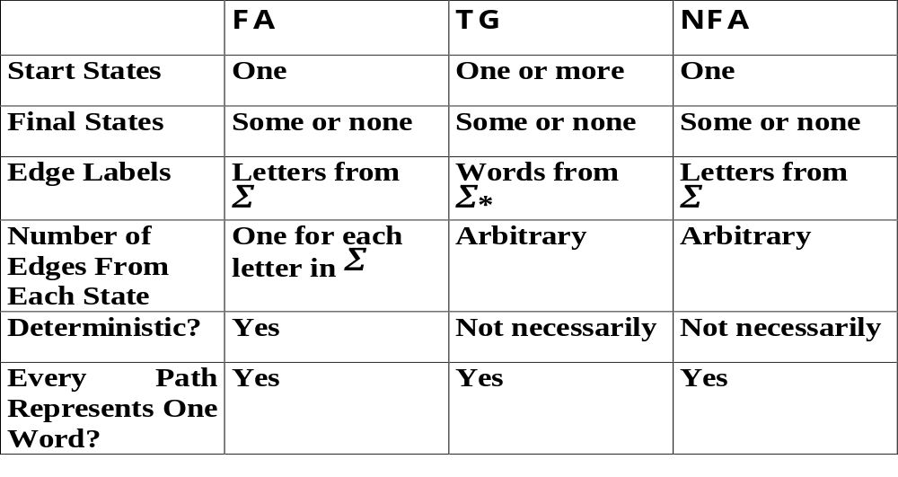
Comparison for DFA, TG and NFA
Yrd. Doç. Dr. R. Cenk Erdur, 2012

Slide 11
Theorem
For every NFA there is some FA that exactly accepts the same language.
  There is a method for converting a NFA to a FA. A concrete example for this method will be given in the class during the lecture.
Yrd. Doç. Dr. R. Cenk Erdur, 2012

